Slide 1
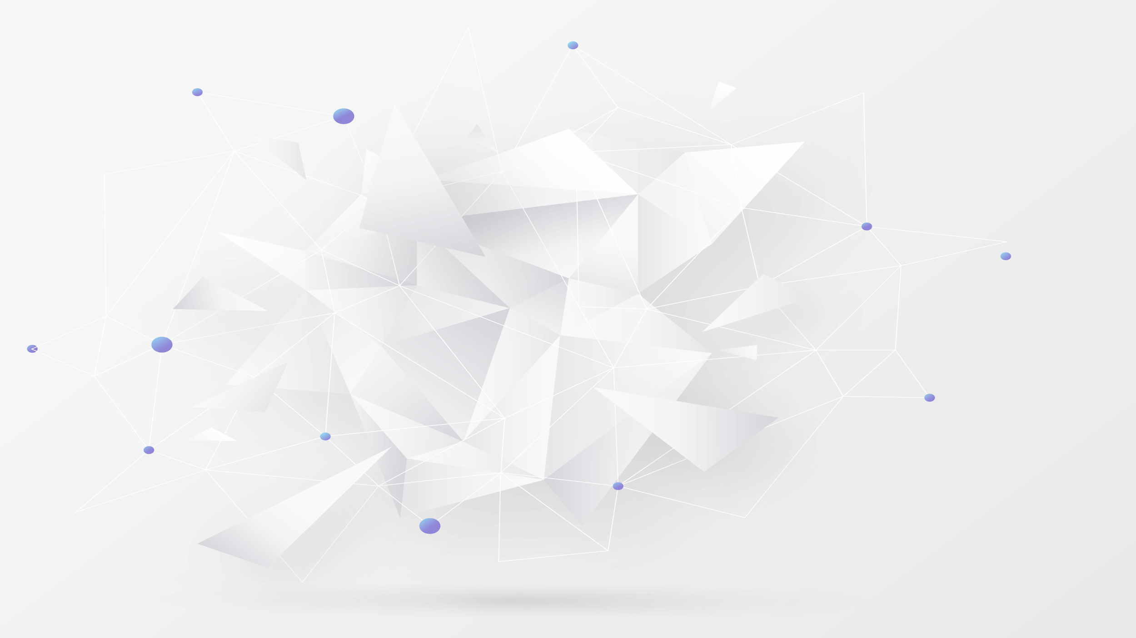
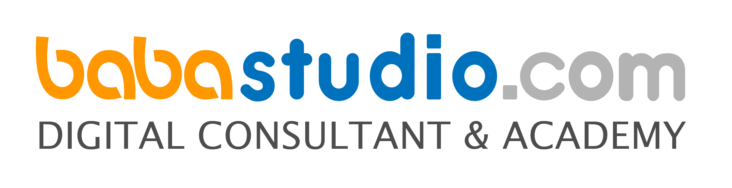
Babastudio

Slide 2


Connection Mongodb
1. Copy latihan middleware yang telah di buat
2. Rename dengan nama latihan_mongodb
3. Tambahkan folder public dan models
4. Download bahan.zip di http://bit.ly/bahan-dtc
5. Copy folder build, dist, docs, plugins ke dalam folder public
6. Copy file ejs ke dalam folder views
7. Install mongoose
npm i --save mongoose

Slide 3
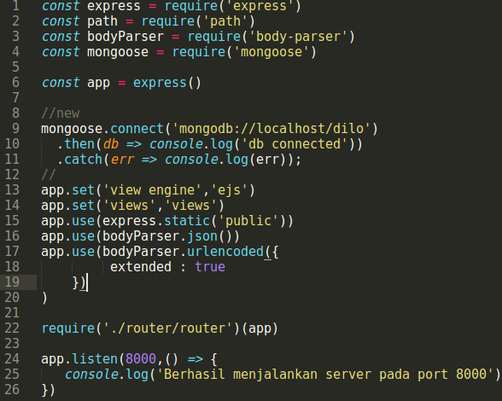
Connection Mongodb
Index.js

Slide 4
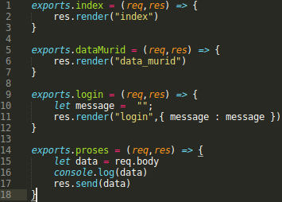
Connection Mongodb
Controller

Slide 5
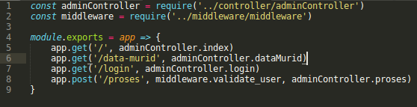
Connection Mongodb
router.js

Slide 6
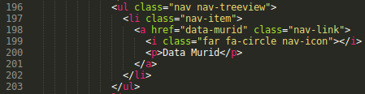
Connection Mongodb
index.ejs

Slide 7
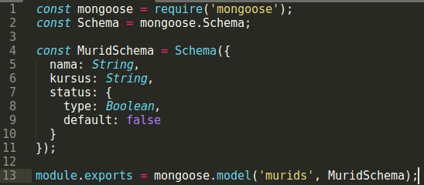
Connection Mongodb
Buat file baru murid.js pada folder models

Slide 8
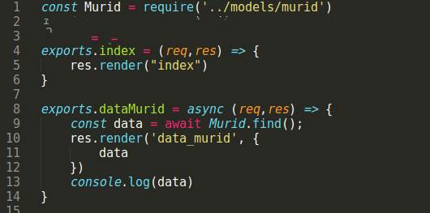
Connection Mongodb
Controller

Slide 9
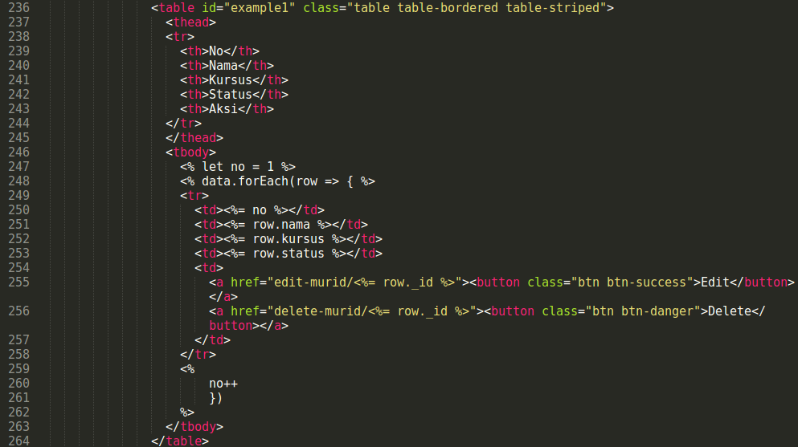
Connection Mongodb
data murid

Slide 10
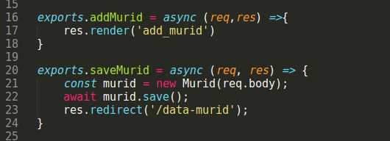
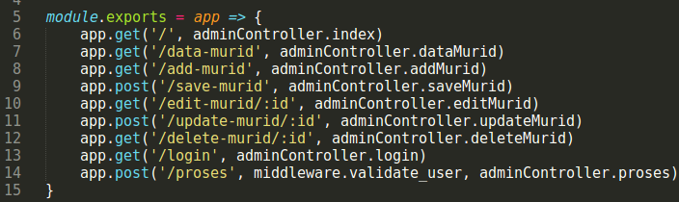
Connection Mongodb
Controller
Route

Slide 11
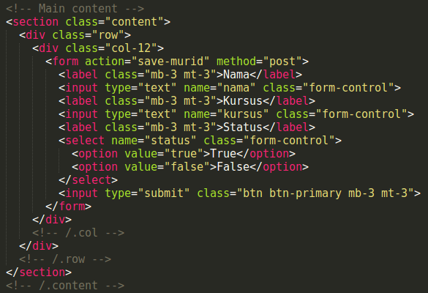
Connection Mongodb
add_murid.ejs

Slide 12
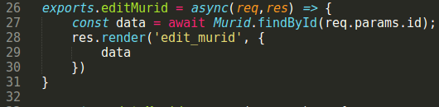
Connection Mongodb
Controller
Route

Slide 13
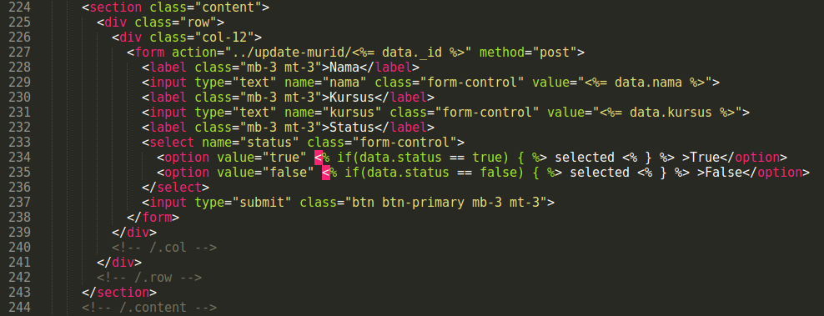
Connection Mongodb
edit_murid.ejs

Slide 14
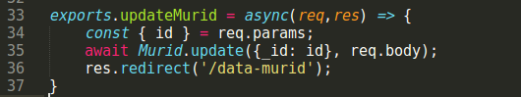
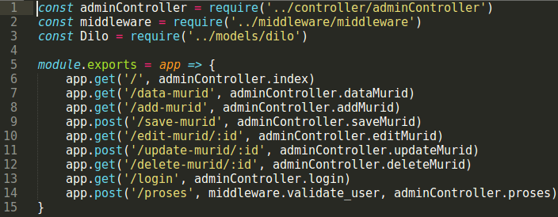
Connection Mongodb
Controller
Route

Slide 15
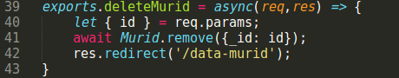
Connection Mongodb

